Slide 1
Statistical Analysis of Sample and Feature Sizes
Giri Anand
4/20/12

Slide 2
Objective
Accurately map significant features (genes, SNPs) to diseases (Alzheimer, Schizophrenia, ADHD)
Take into account sample size to feature ratio in studies
A large sample size to feature ratio indicates higher precision
A small sample size to feature ratio indicates lower precision
Look at sample and feature data in various databases to observe a trend in sample and feature sizes

Slide 3
GEO (Gene Expression Omnibus)
Genomics data repository
Studies on various organisms (mice, humans, flies, etc.)
2721 data sets
Information on sample size, feature size, year, etc.
    Accessible through Bioconductor package GEOmetadb (converts matrices into eSet class, can be manipulated using R)
Using data sets, determine “average” (mean and median) sample count and feature count
  sorted into two 4-year windows (2003-06, 2007-10)
  sorted into a moving 5-year window (03-07, 04-08, 05-09, 06-10)
Perform statistical tests to show whether there is a significant change in the sample size, feature size, and the sample to feature ratio from one window to another

Slide 4
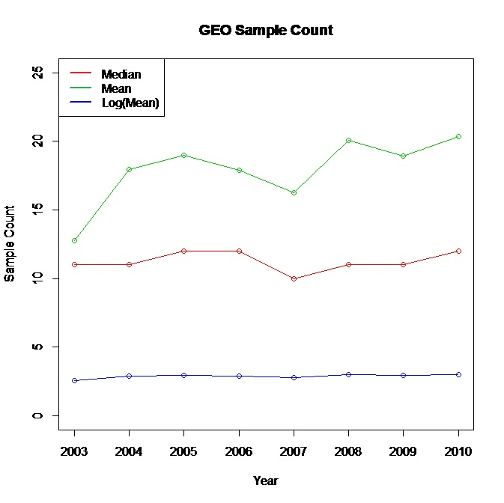
GEO: Year-by-Year (Sample Sizes)

Slide 5
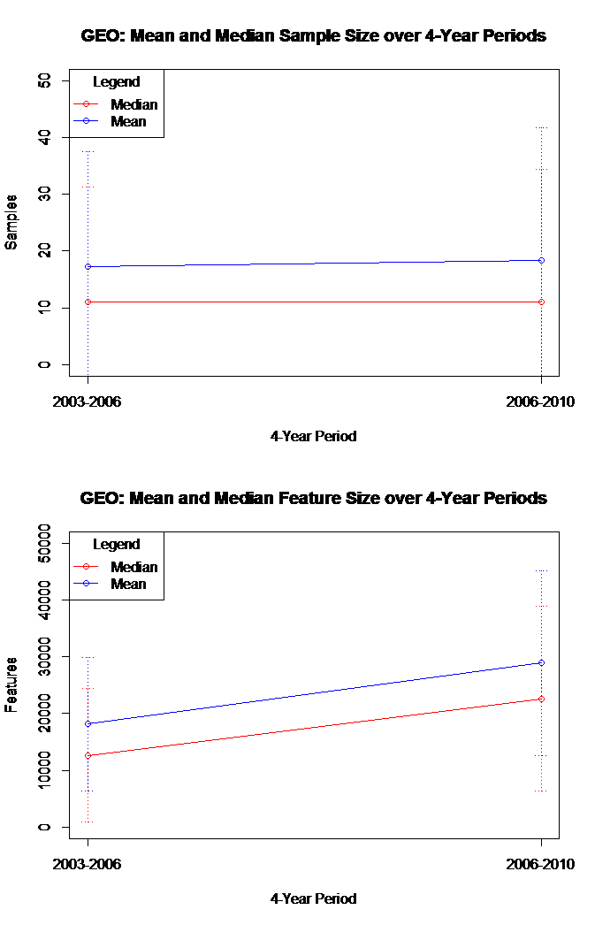
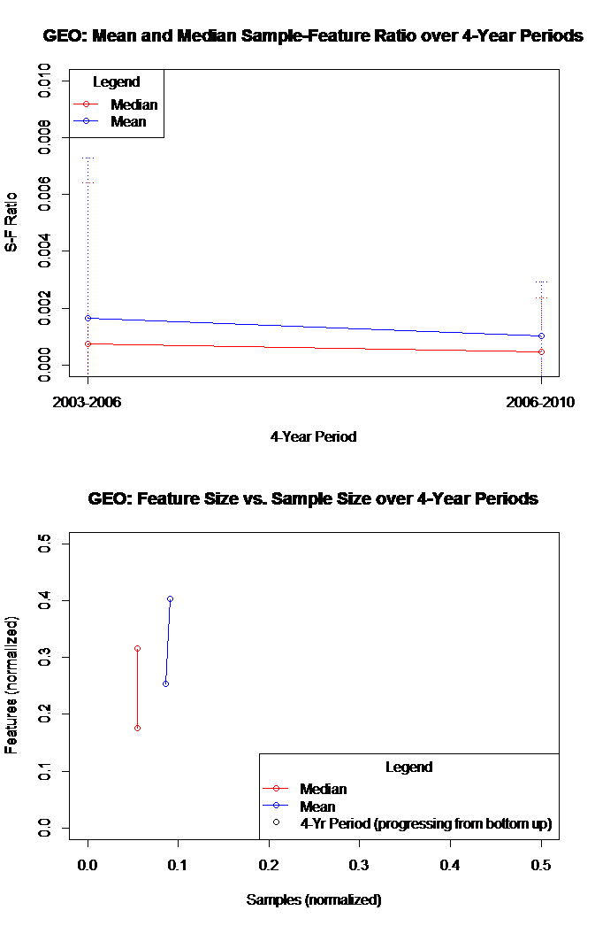

Slide 6
GEO: 4-Year Window Results
2003-2006: 1386 datasets
  Sample size: 11 (median), 17.28139 (mean)
  Feature size: 12654 (median), 18168 (mean)
  S-F ratio: 0.0007374178 (median), 0.001636094 (mean)
2004-2008: 1335 datasets
  Sample size: 11 (median), 18.37903 (mean)
  Feature size: 22645 (median), 28920 (mean)
  S-F ratio: 0.0004545971 (median), 0.001016699 (mean)

Slide 7
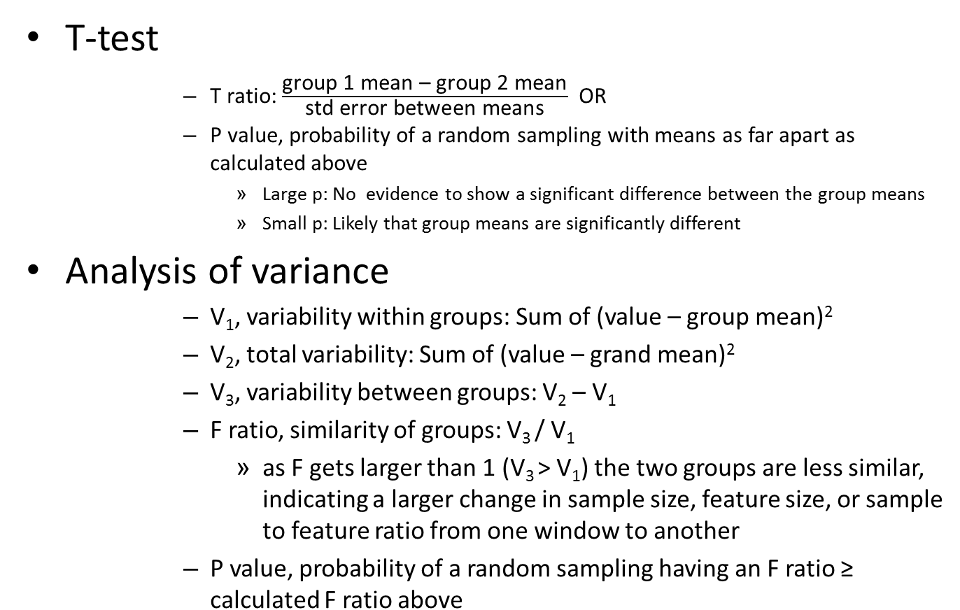

Statistical Tests

Slide 8
GEO: 4-Year Window Analysis
Mean Fill-in |  | Median Fill-in |  | No Fill-in
T (P) | F (P) | T (P) | F (P) | T (P) | F (P)
SAMPLES
-1.334 (0.1823) | 1.404 (0.236) | -1.003 (0.316) | 1.366 (0.243) | -1.3057 (0.1918) | 1.399 (0.237)
FEATURES
-20.202 (< 2.20E-16) | 13.38 (2.65E-04) | -19.733 (< 2.20E-16) | 9.212 (2.45E-03) | -19.710 (< 2.20E-16) | 14.89 (1.19E-04)
SAMPLE-FEATURE RATIO
3.9497 (8.15E-05) | 0.036 (0.849) | 3.9838 (7.07E-05) | 0.04 (0.842) | 3.8478 (1.24E-04) | 0.028 (0.868)
Trends
Samples: Low T and F ratios, high P values → Significant difference between groups? NO
Features: High T and F ratios, low P values → Significant difference between groups? YES
S-F Ratio: High T ratio, low F ratio, varying P values → Significant difference between groups?

Slide 9
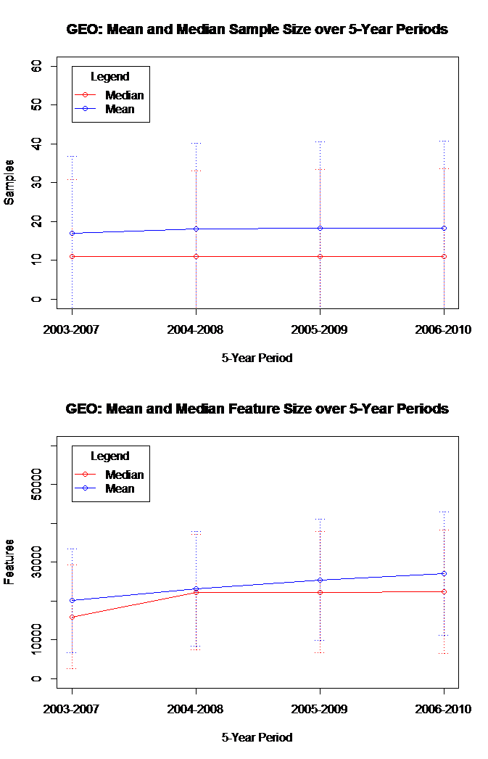
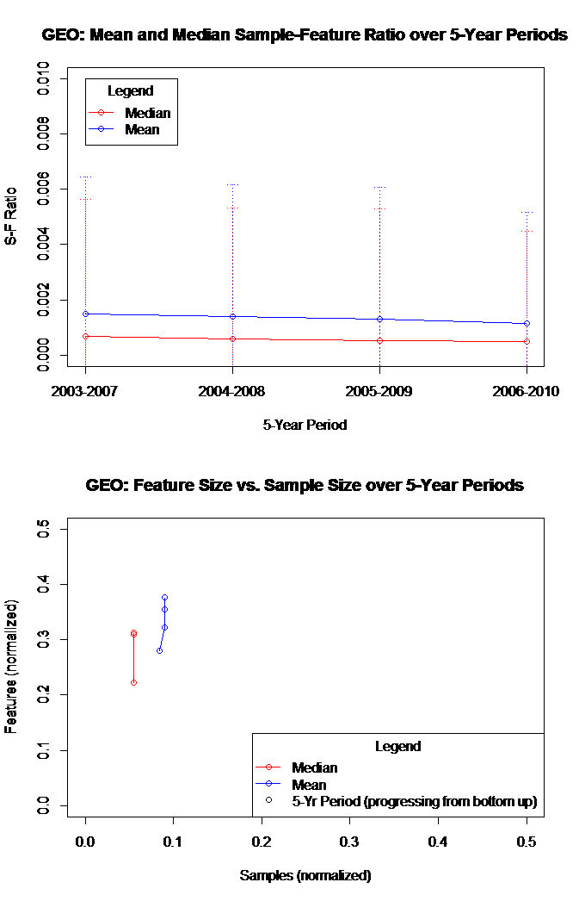
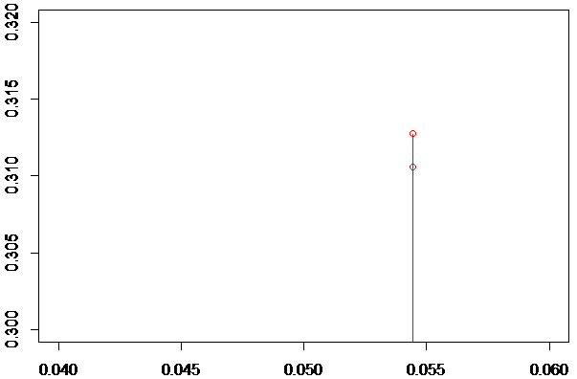
Zoomed in

Slide 10
GEO: 5-Year Moving Window Results
2003-2007: 1927 datasets
  Sample size: 11 (median), 16.99689 (mean)
  Feature size: 15923 (median), 20099.97 (mean)
  S-F Ratio: 0.0006818957 (median), 0.001495661 (mean)
2004-2008: 2138 datasets
  Sample size: 11 (median), 18.08887 (mean)
  Feature size: 22283 (median), 23177.36 (mean)
  S-F Ratio: 0.0005867643 (median), 0.001410198 (mean)
2005-2009: 2034 datasets
  Sample size: 11 (median), 18.19715 (mean)
  Feature size: 22283 (median), 25468.62 (mean)
  S-F Ratio: 0.0005321390 (median), 0.001308586 (mean)
2006-2010: 1892 datasets
  Sample size: 11 (median), 18.23784 (mean)
  Feature size: 22444 (median), 27086.54 (mean)
  S-F Ratio: 0.0005021185 (median), 0.001161465 (mean)

Slide 11
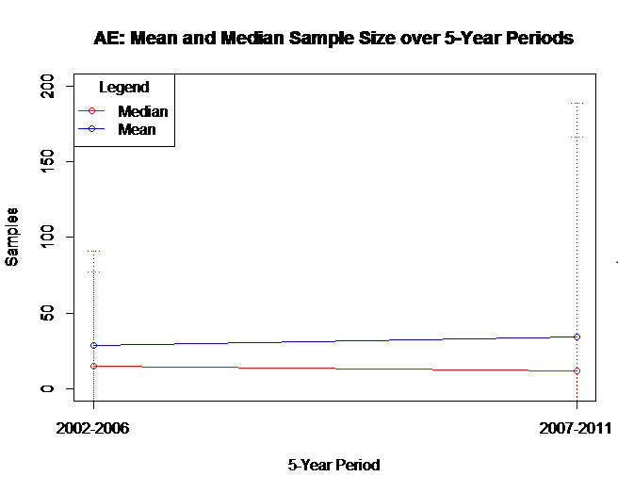
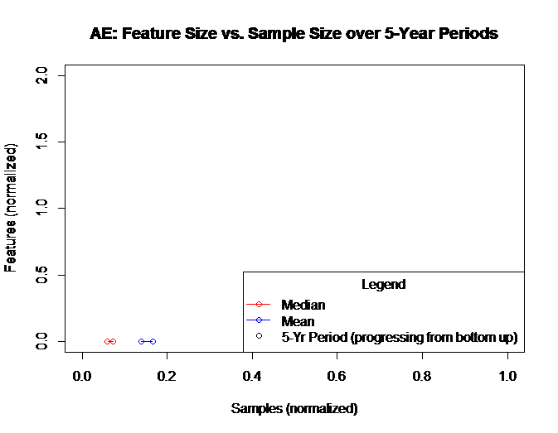
ArrayExpress Results
Almost 6000 datasets
Can only extract sample sizes by downloading public Excel File, not features

Slide 12
Possible Method to Extract Features in AE
for(i in 1:5894){
feature_count=c(feature_count,length(featureNames(ArrayExpress(ads.count.year[i,1]))))
}
ads.count.year[,4]=feature_count
names(ads.count.year[,4])<-c("feature_count")

Slide 13
Other Databases
Genomics
Gene Expression Omnibus (GEO)
ArrayExpress (AE)
Gene Ontology Annotation (GOA)
The Cancer Genome Atlas (TCGA)
Database of Genotypes and Phenotypes (dbGaP)
Epigenomics
Human Epigenome Atlas
NCBI Epigenomics Data
Proteomics
Proteomics Identifications Database (PRIDE)
Global Proteome Machine Database (GPMDB)
Peptide Atlas
NIST Proteomics Data
BiblioSpec Data

Slide 14
Sources
http://www.graphpad.com/articles/interpret/principles/stat_principles.htm
http://www.statmethods.net/stats/
http://www.statmethods.net/graphs/index.html
http://rss.acs.unt.edu/Rdoc/library/gplots/html/plotCI.html

